Slide 1
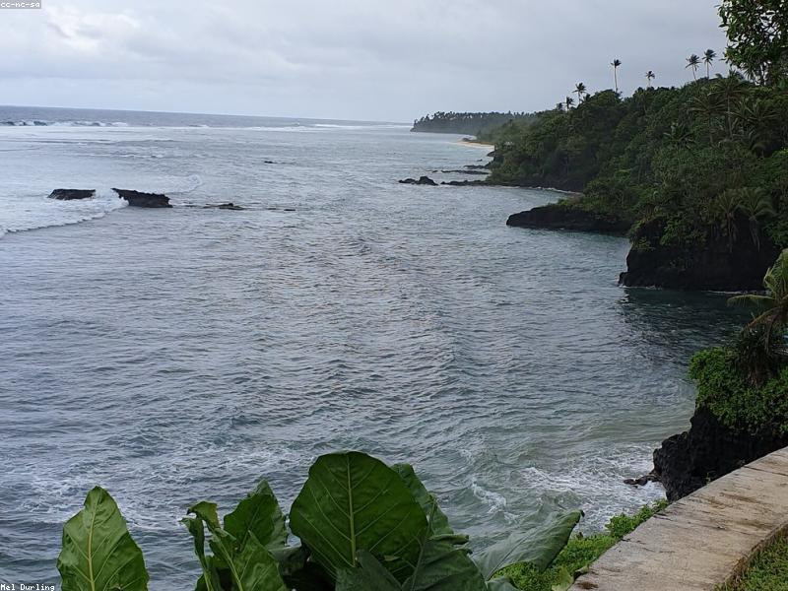
Introduction to the Mariana's Trench
- The Mariana's Trench is the deepest part of the world's oceans, reaching depths of over 36,000 feet.
- It is located in the western Pacific Ocean, east of the Mariana Islands.

Slide 2
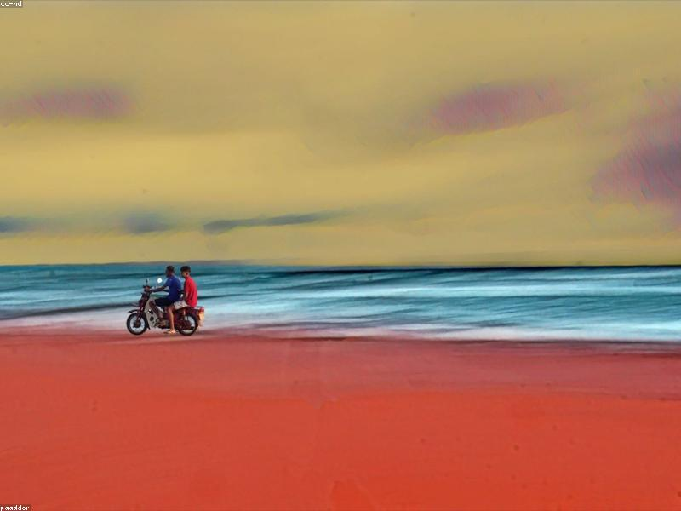
Unique Ecosystems
- The trench hosts unique ecosystems that thrive under extreme pressure and darkness.
- Organisms have adapted to survive in these harsh conditions, showcasing incredible biodiversity.

Slide 3

Notable Species
- The amphipod known as the 'deep-sea snailfish' has been recorded at depths of 8,000 meters.
- Other notable species include giant tube worms and various types of bioluminescent organisms.

Slide 4
Research and Exploration
- Research missions have used submersibles to explore the trench, revealing new species and geological features.
- The trench remains one of the least explored areas of the ocean, with many mysteries yet to uncover.

Slide 5
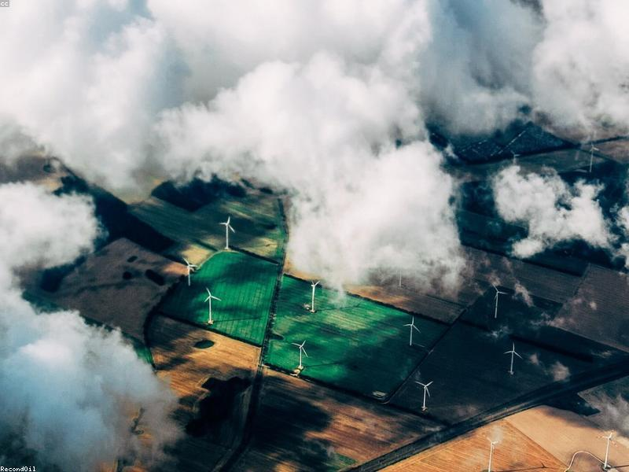
Conservation Challenges
- The Mariana's Trench faces threats from deep-sea mining and pollution.
- Conservation efforts are crucial to protect the unique wildlife and ecosystems found in this region.

